Slide 1
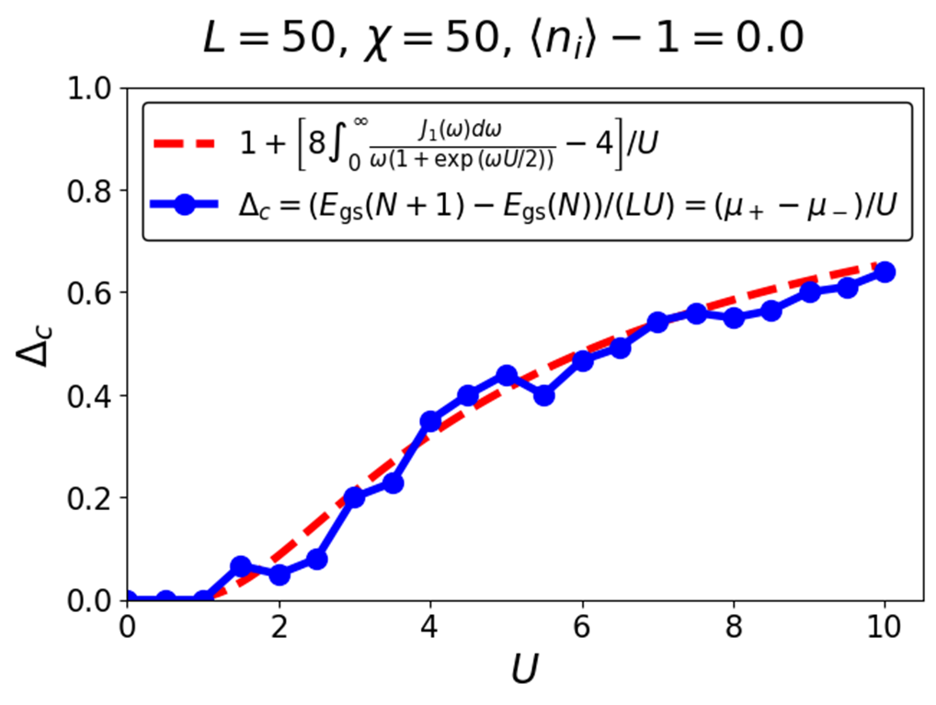
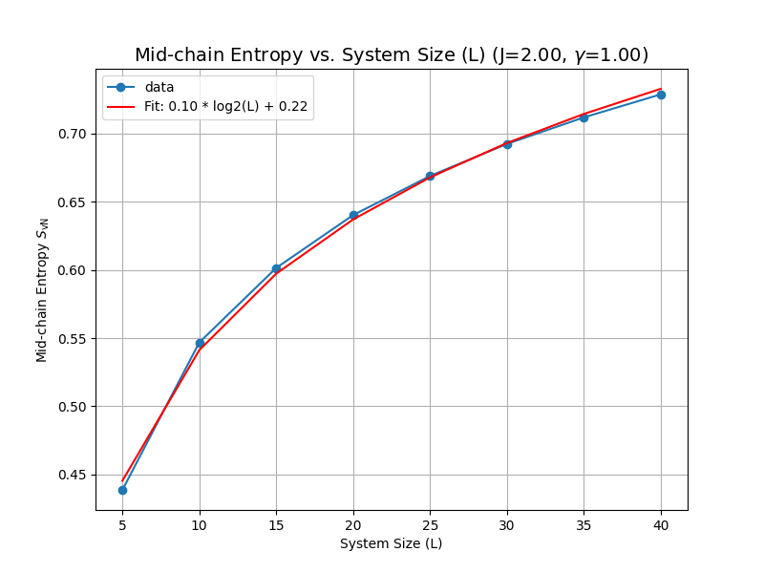
DMRG on various one-dimensional Hamiltonians
Machine Learning and Computational Physics Final Project
SungBin Lee, Sehyun Oh, and JunSoo Kim
Dept. of Physics and Astronomy, Seoul National University

Slide 2
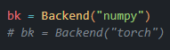
시작하기 앞서…
본 프로젝트의 모든 결과물은 아래 조건을 준수하였습니다.
Python 기본 패키지(e.g. numpy)에서 시작
하이레벨 패키지 미사용(e.g. TeNPy, torch.nn)
Laptop / Desktop 수준의 컴퓨팅 자원 활용
CPU와 CUDA에서 모두 작동하도록 설계
וְהָיָ֣ה רֵאשִׁיתְךָ֣ מִצְעָ֑ר וְ֝אַחֲרִיתְךָ֗ יִשְׂגֶּ֥ה מְאֹֽד
네 시작은 미약(微弱)하였으나 네 나중은 심히 창대(昌大)하리라
욥기 8장 7절, 개역 성경

Slide 3
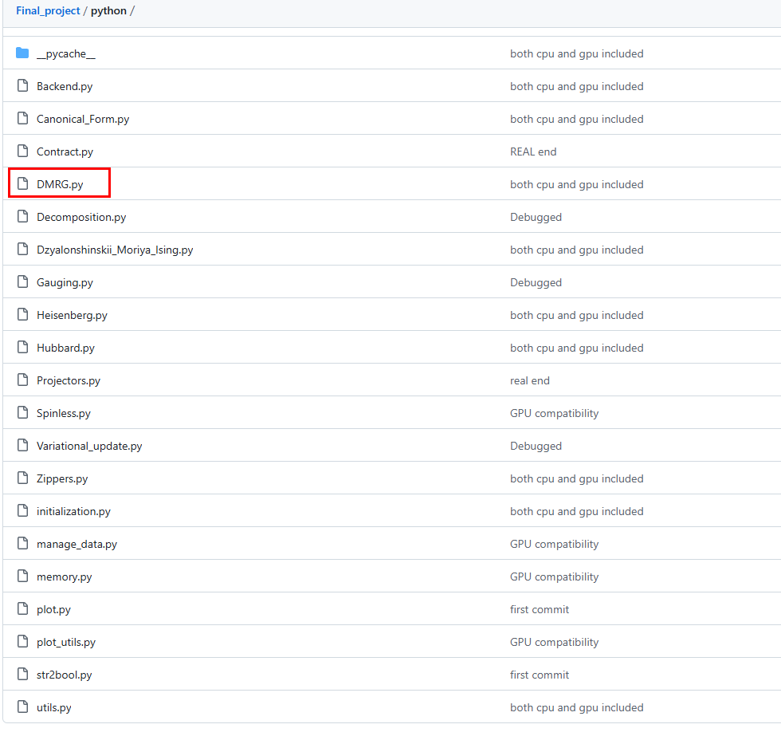
DMRG code on Github

Slide 4
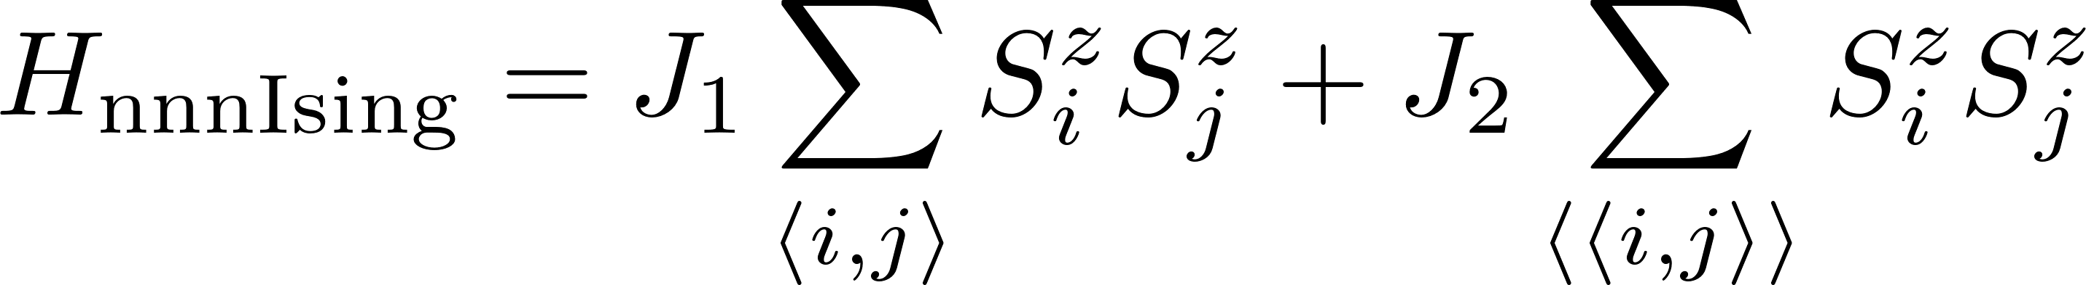
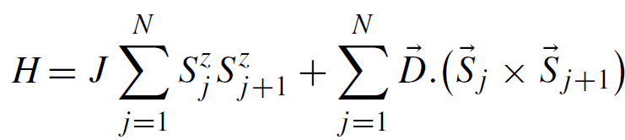
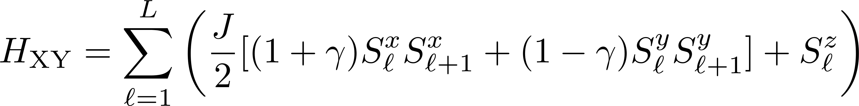
Solving quantum many-body Hamiltonians with DMRG
Next-nearest neighborhood Ising model (SungBin Lee)
Dzyaloshinskii Moriya Ising model (Sehyun Oh)
XY model with area-law of entanglement (JunSoo Kim)
Heisenberg XXZ chain (SungBin Lee)
Single-orbital Fermi-Hubbard model (SungBin Lee)

Slide 5
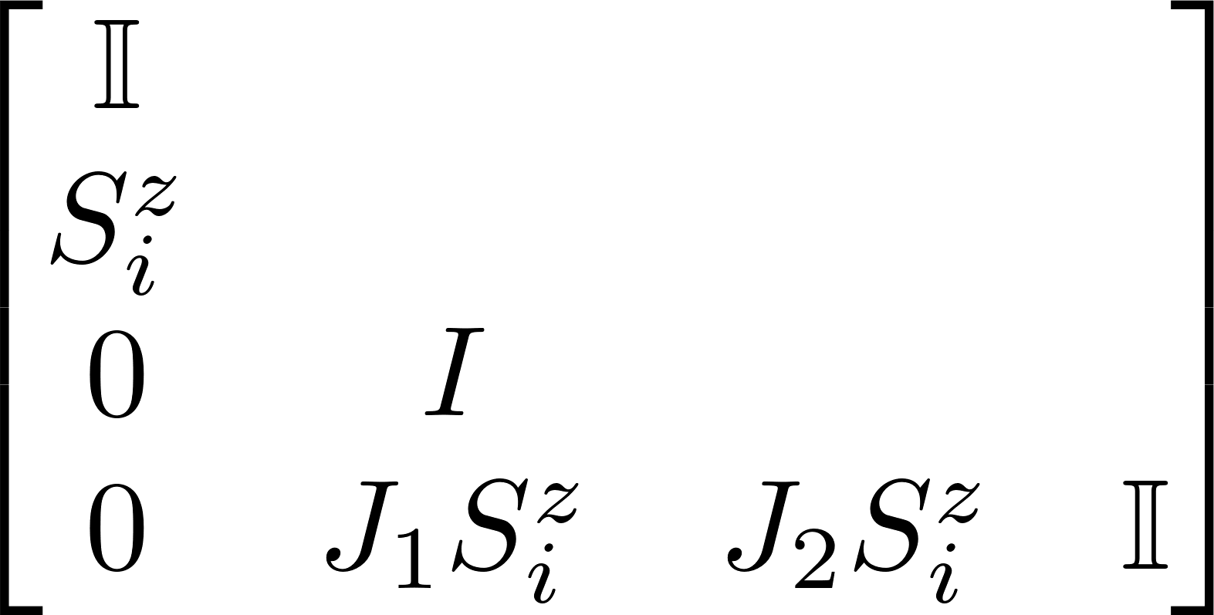
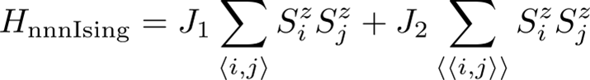
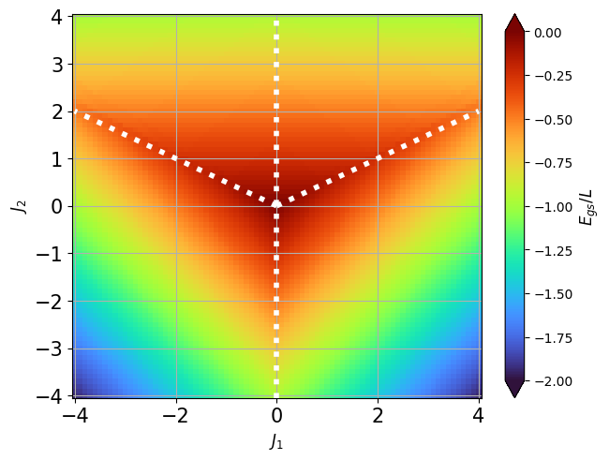
Next-nearest neighborhood Ising model
Ferromagnetic, Antiferromagnetic, Frustrated phase
Rich ground state phase properties in a simple model

Slide 6
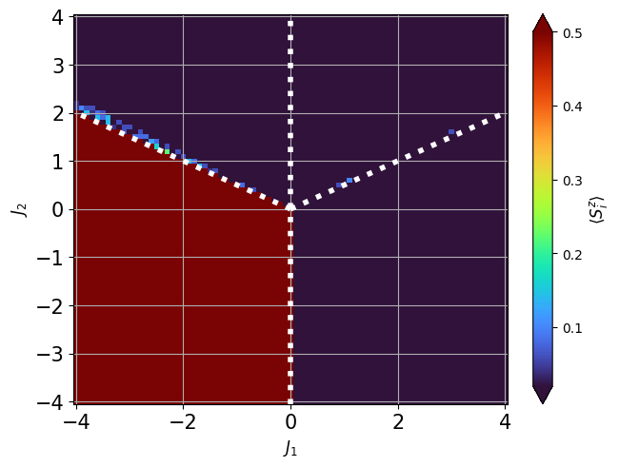
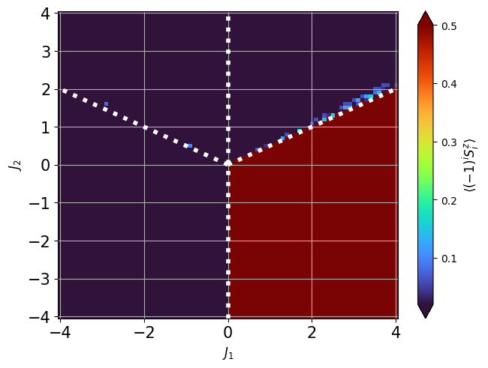
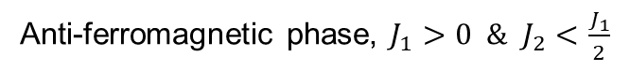
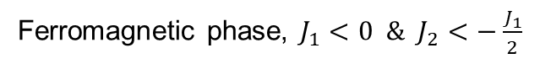
Next-nearest neighborhood Ising model: order parameters
Ferromagnetic phase, $J_{1}<0 \& J_{2}<−\frac{J_{1}}{2}$
Anti-ferromagnetic phase, $J_{1}>0 \& J_{2}<\frac{J_{1}}{2}$

Slide 7
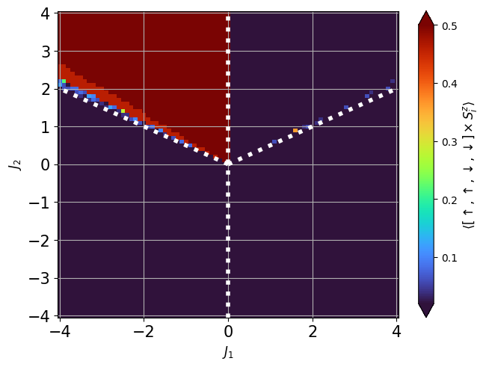
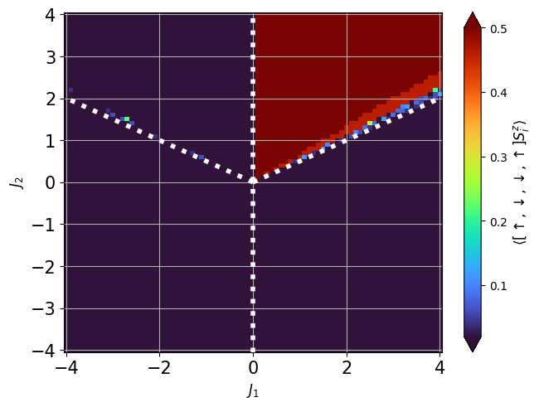
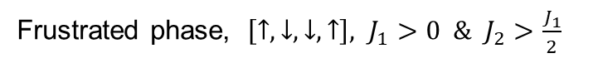
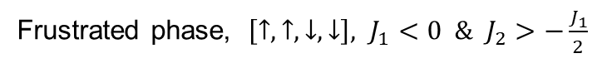
Next-nearest neighborhood Ising model: order parameters
Frustrated phase, $\left[↑, ↑, ↓, ↓\right], J_{1}<0 \& J_{2}>−\frac{J_{1}}{2}$
Frustrated phase, $\left[↑, ↓, ↓, ↑\right], J_{1}>0 \& J_{2}>\frac{J_{1}}{2}$

Slide 8
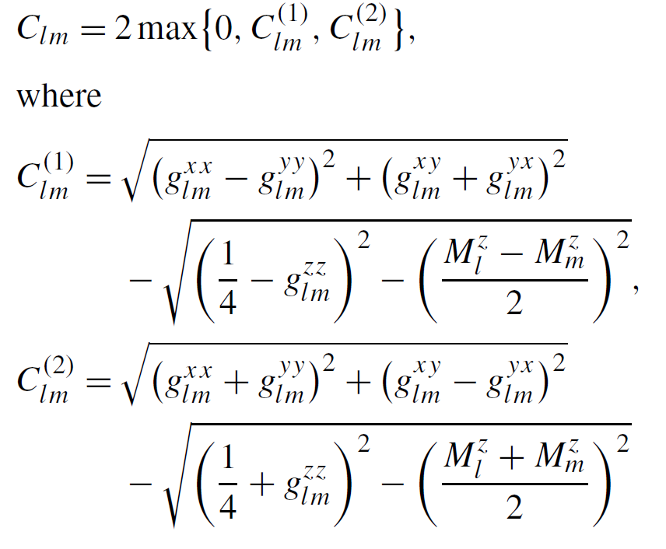
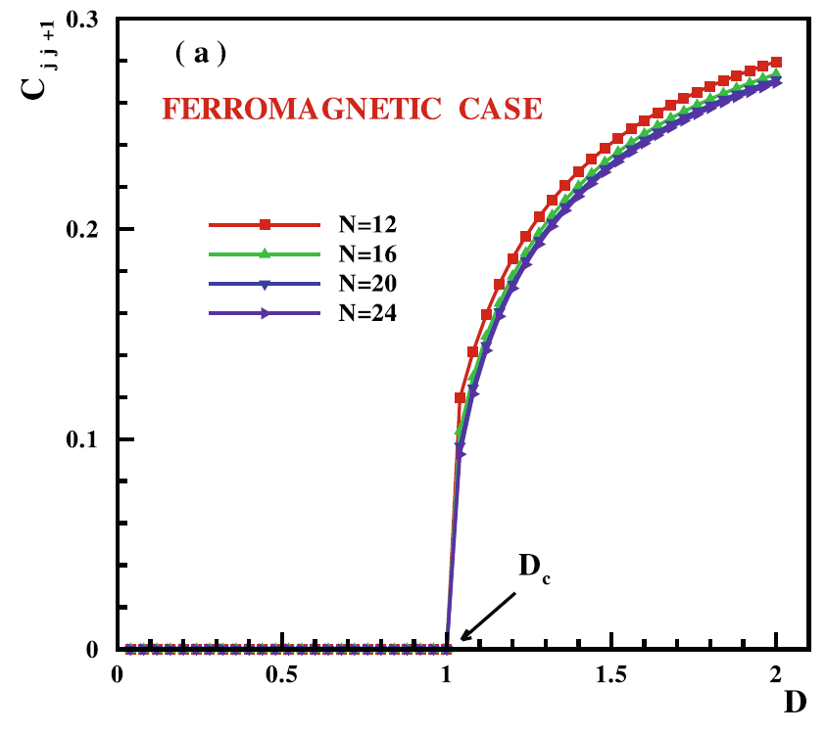
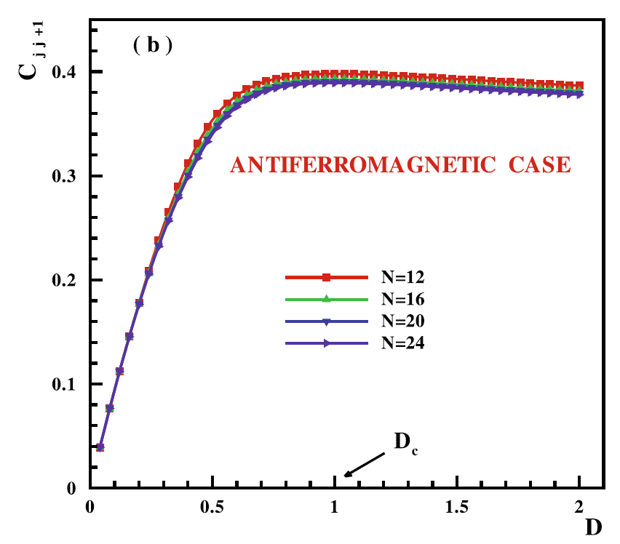
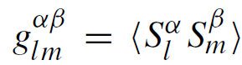
Entanglement Study of the 1D Ising + DM Interaction Model
1D Ising Model + DM Interaction could induce spiral-FM and spiral-AFM phase and a commensurate - incommensurate quantum phase transition (QPT) at Dc=|J|.
Concurrence quantifies the pairwise entanglement btw two spins
Which is an indicator of QPT.
Could we capture QPT with DMRG? (Paper used Lanczos for approx. ED)
J. Vahedi, JSNM (2012)

Slide 9
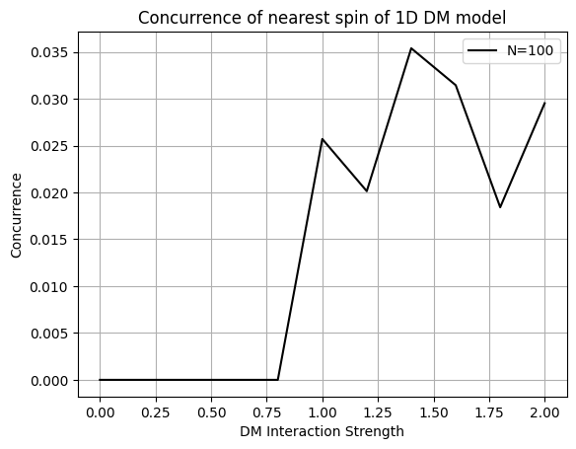
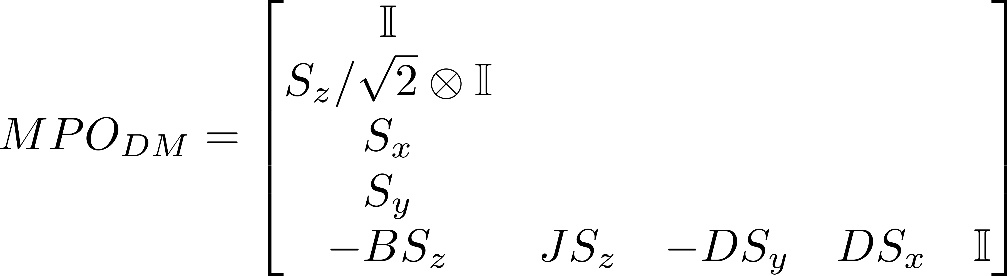
Entanglement Study of the 1D Ising Model with DM interaction
DMRG Setting:
J = 1 (FM), L = 100, Nkeep = 30
QPT occurs at Dc=J=1 in FM case
Concurrence fluctuation after the QPT?
(1) Open Boundary condition? (Paper used PBC)
(2) Existence of metastable states?

Slide 10
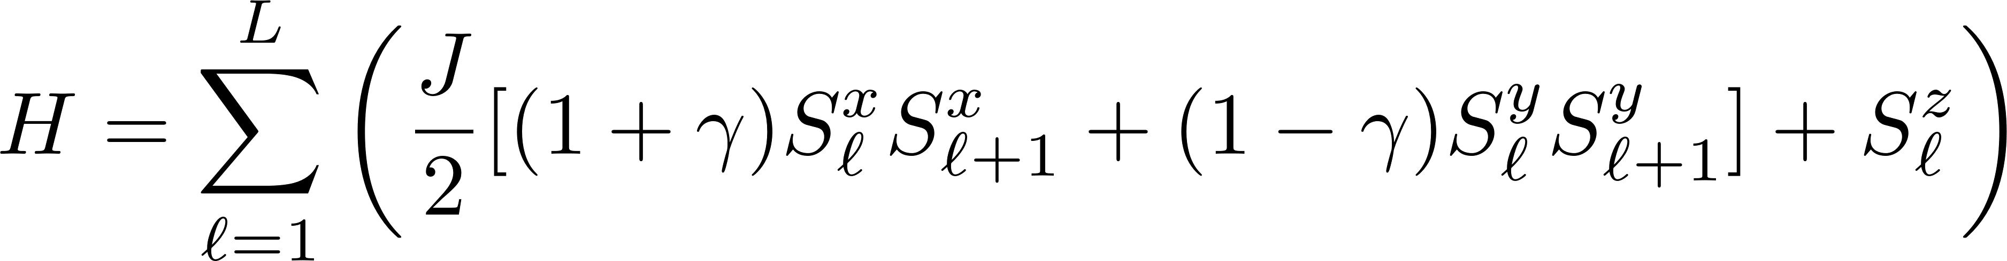
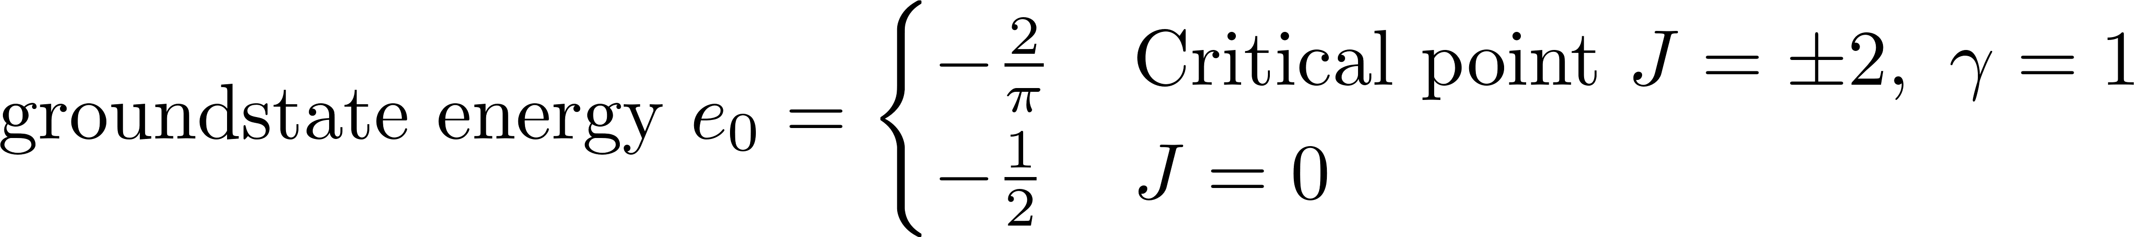
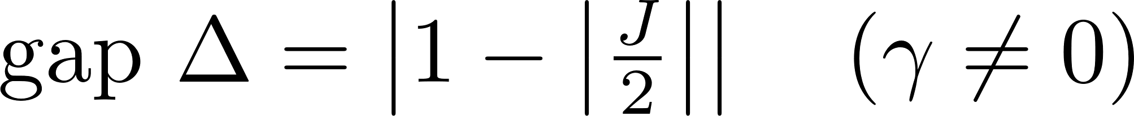
Heisenberg XY model

Slide 11
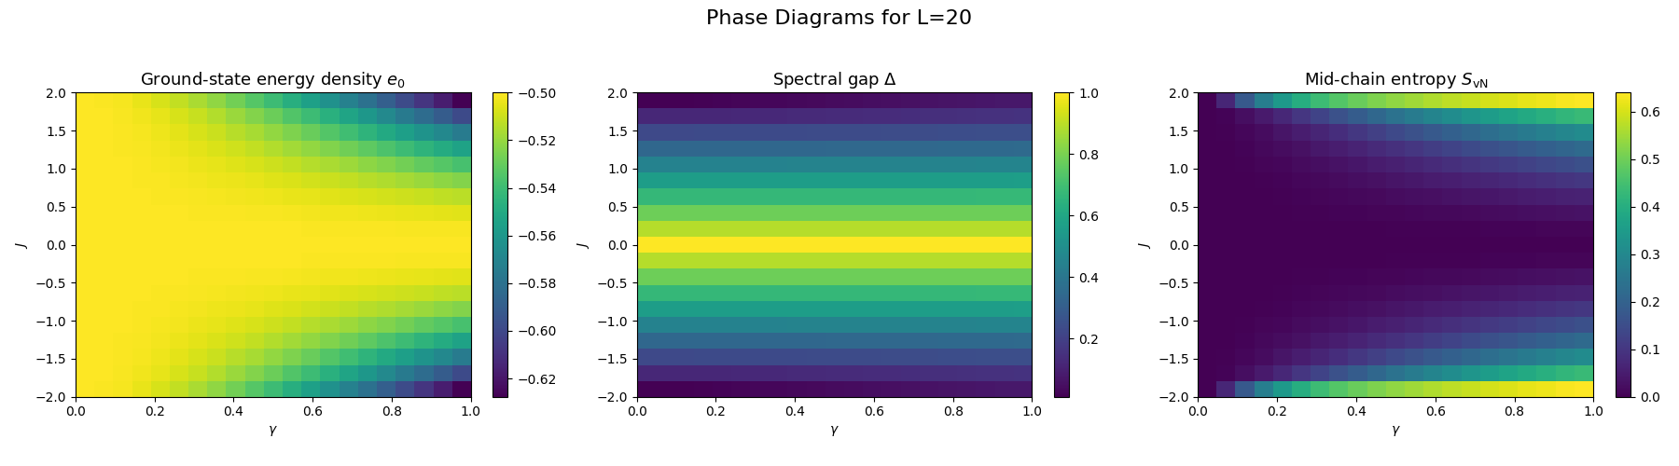

Heisenberg XY model

Slide 12
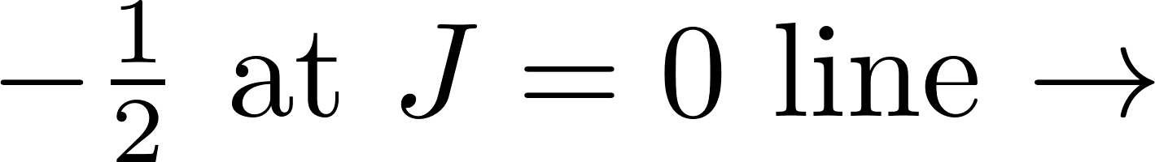
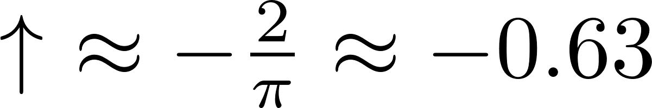
Detailed phase diagram

Slide 13
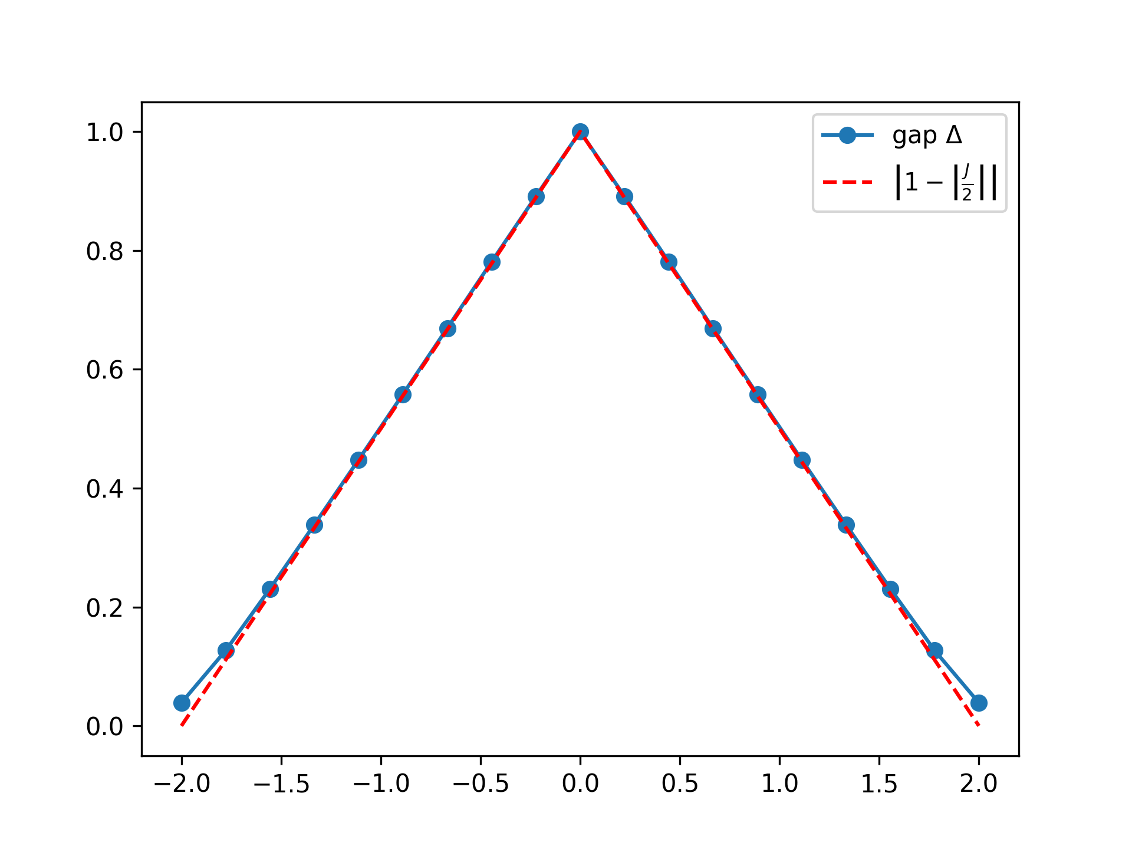
Detailed phase diagram

Slide 14
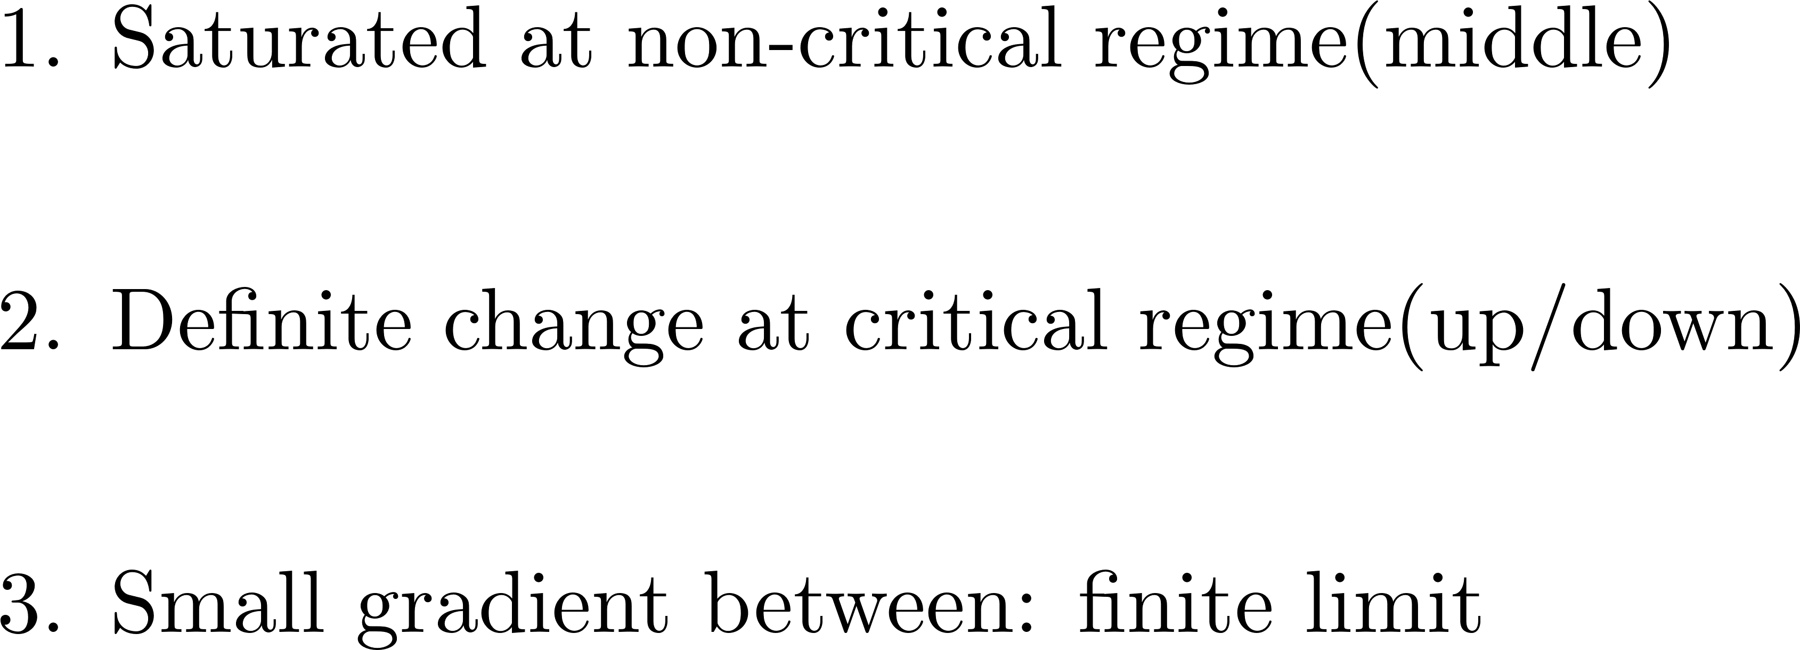
Detailed phase diagram

Slide 15
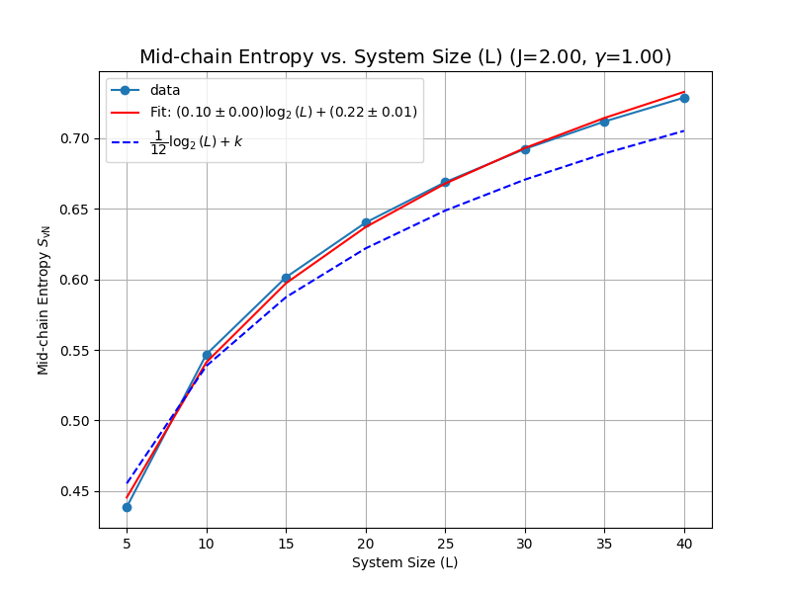
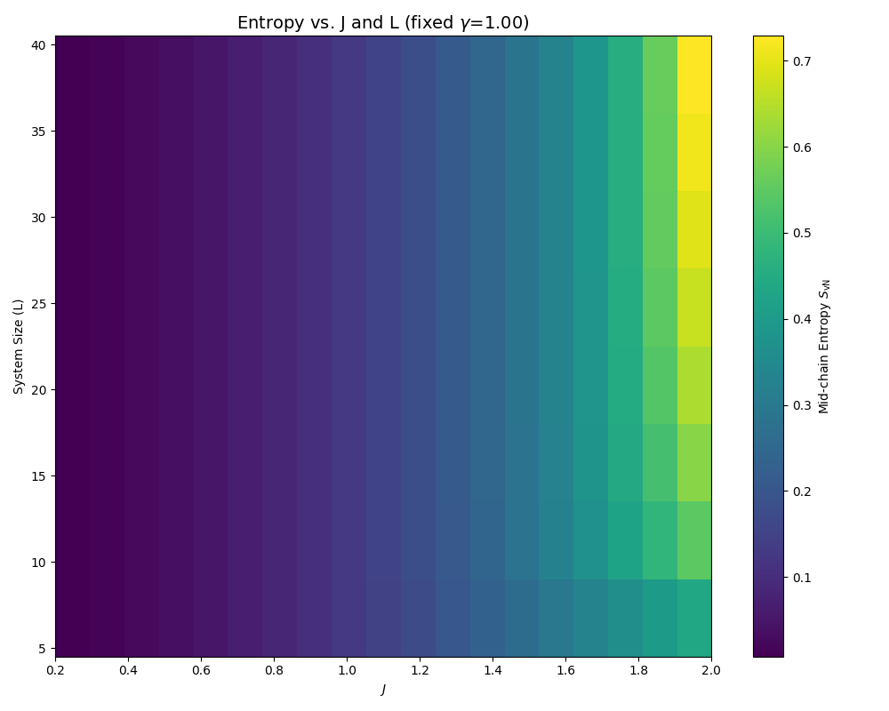
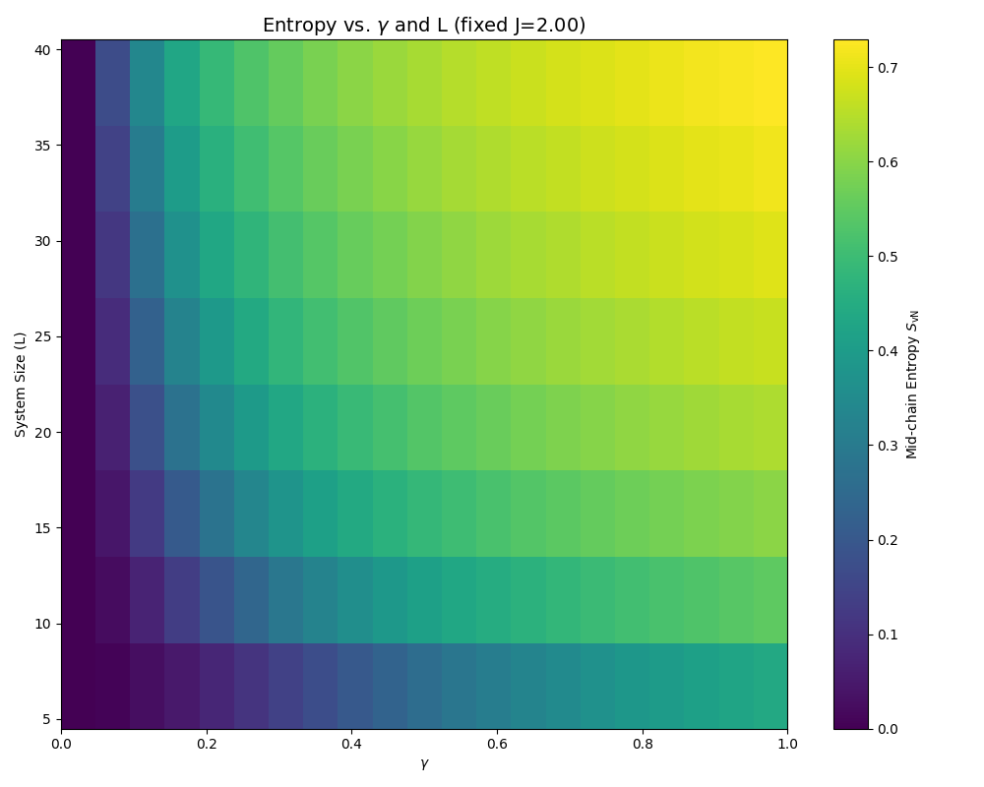
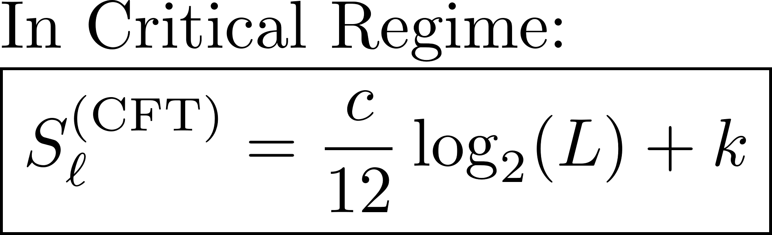
Mid-chain entropy: log(L) behavior

Slide 16
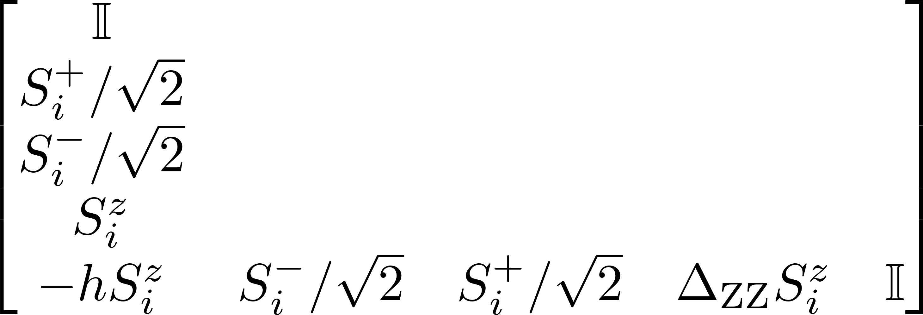
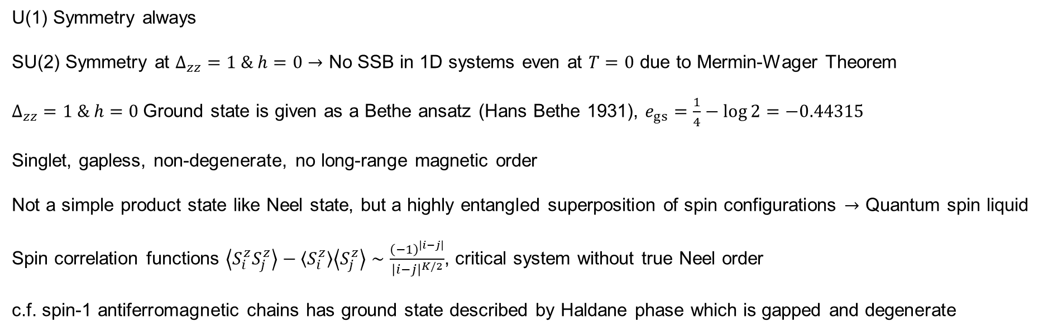
Heisenberg XXZ chain
U(1) Symmetry always
SU(2) Symmetry at $Δ_{zz}=1 \& h=0→$ No SSB in 1D systems even at $T=0$ due to Mermin-Wager Theorem
$Δ_{zz}=1 \& h=0$Ground state is given as a Bethe ansatz (Hans Bethe 1931), $e_{gs}=\frac{1}{4}−\log{2}=−0.44315$
Singlet, gapless, non-degenerate, no long-range magnetic order
Not a simple product state like Neel state, but a highly entangled superposition of spin configurations $→$ Quantum spin liquid
Spin correlation functions $\left\langle S_{i}^{z}S_{j}^{z}\right\rangle −\left\langle S_{i}^{z}\right\rangle \left\langle S_{j}^{z}\right\rangle ∼\frac{{\left(−1\right)}^{\left|i−j\right|}}{{\left|i−j\right|}^{K/2}}$, critical system without true Neel order
c.f. spin-1 antiferromagnetic chains has ground state described by Haldane phase which is gapped and degenerate
S. R. White, PRL (1992)

Slide 17
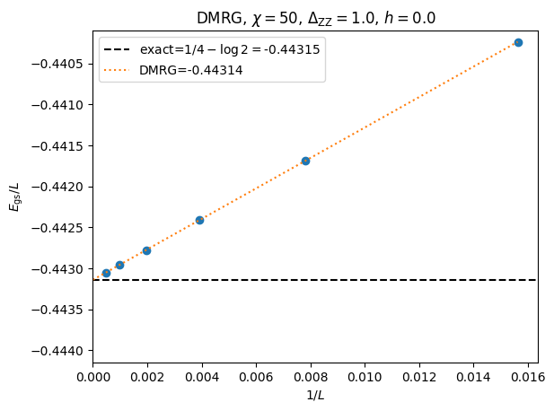
Heisenberg XXZ chain: compare with Bethe ansatz
S. R. White, PRL (1992)
Accurate up to 5 significant digits !!

Slide 18
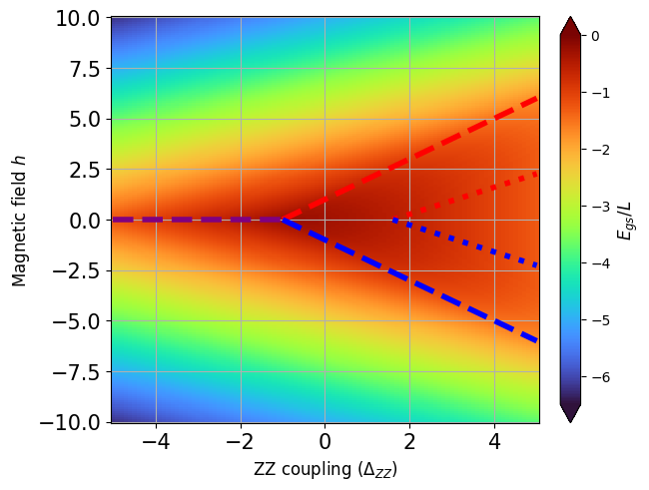
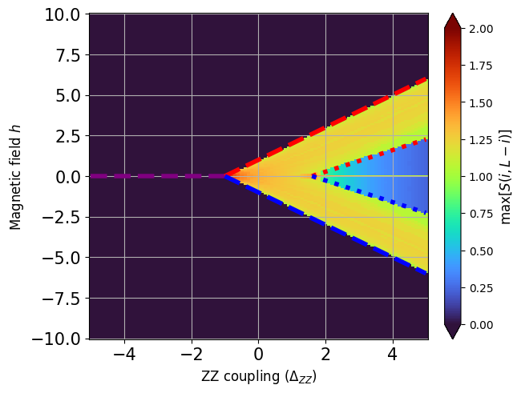
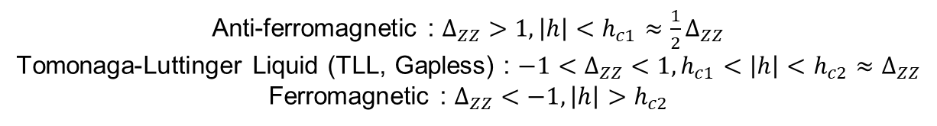
Heisenberg XXZ chain: ground state energy
Anti-ferromagnetic : $Δ_{ZZ}>1, \left|h\right|<h_{c1}≈\frac{1}{2}Δ_{ZZ}$
Tomonaga-Luttinger Liquid (TLL, Gapless) : $−1<Δ_{ZZ}<1,h_{c1}<\left|h\right|<h_{c2}≈Δ_{ZZ}$
Ferromagnetic : $Δ_{ZZ}<−1, \left|h\right|>h_{c2}$

Slide 19
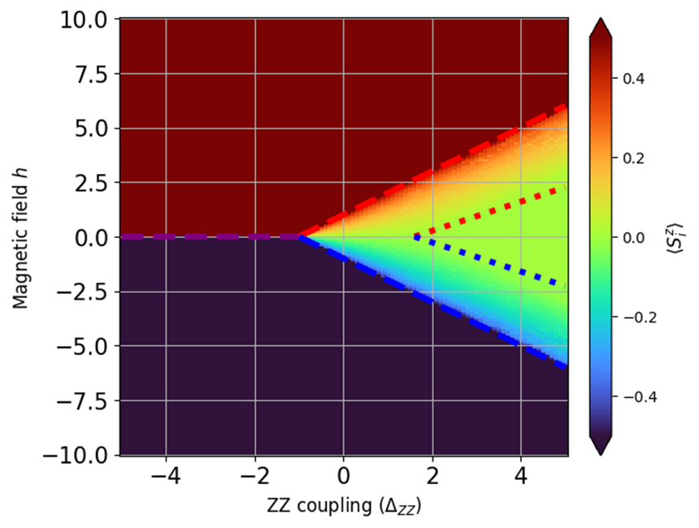
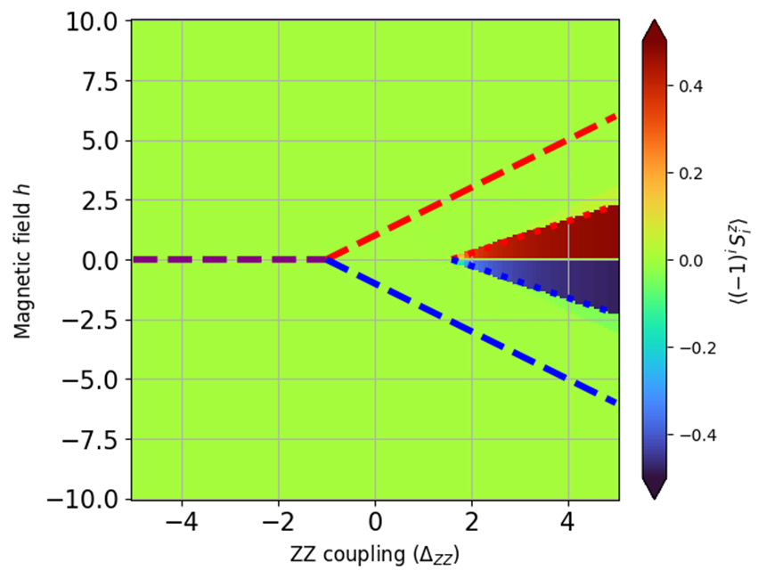
Heisenberg XXZ chain: order parameters
Anti-ferromagnetic : $Δ_{ZZ}>1, \left|h\right|<h_{c1}≈\frac{1}{2}Δ_{ZZ}$
Tomonaga-Luttinger Liquid (TLL, Gapless) : $−1<Δ_{ZZ}<1,h_{c1}<\left|h\right|<h_{c2}≈Δ_{ZZ}$
Ferromagnetic : $Δ_{ZZ}<−1, \left|h\right|>h_{c2}$

Slide 20
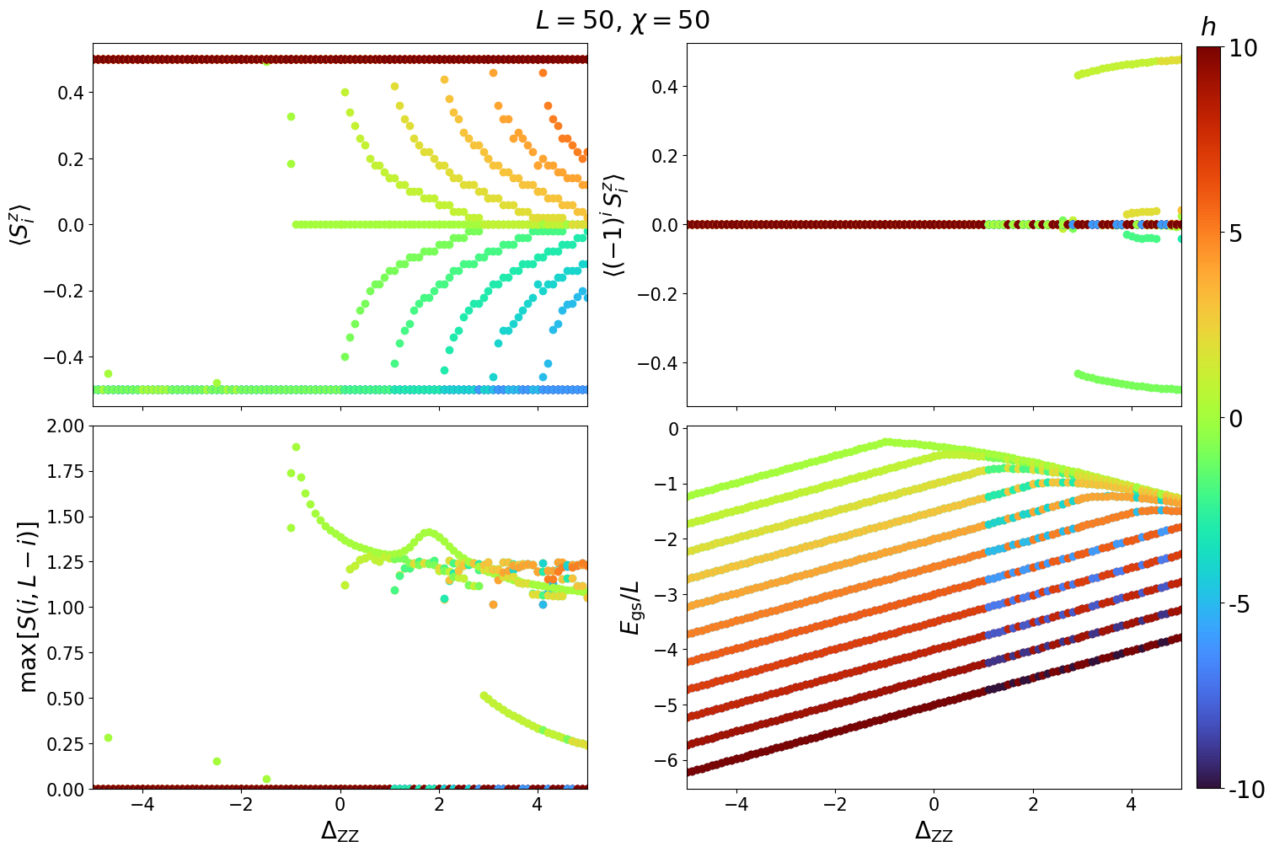
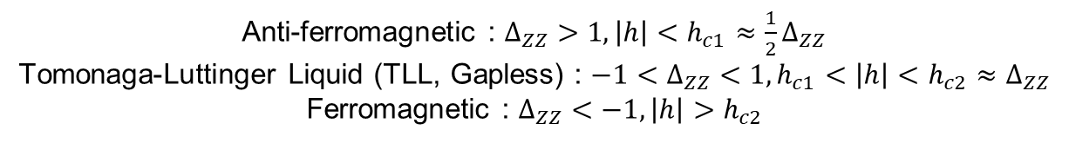
Heisenberg XXZ chain
Anti-ferromagnetic : $Δ_{ZZ}>1, \left|h\right|<h_{c1}≈\frac{1}{2}Δ_{ZZ}$
Tomonaga-Luttinger Liquid (TLL, Gapless) : $−1<Δ_{ZZ}<1,h_{c1}<\left|h\right|<h_{c2}≈Δ_{ZZ}$
Ferromagnetic : $Δ_{ZZ}<−1, \left|h\right|>h_{c2}$

Slide 21
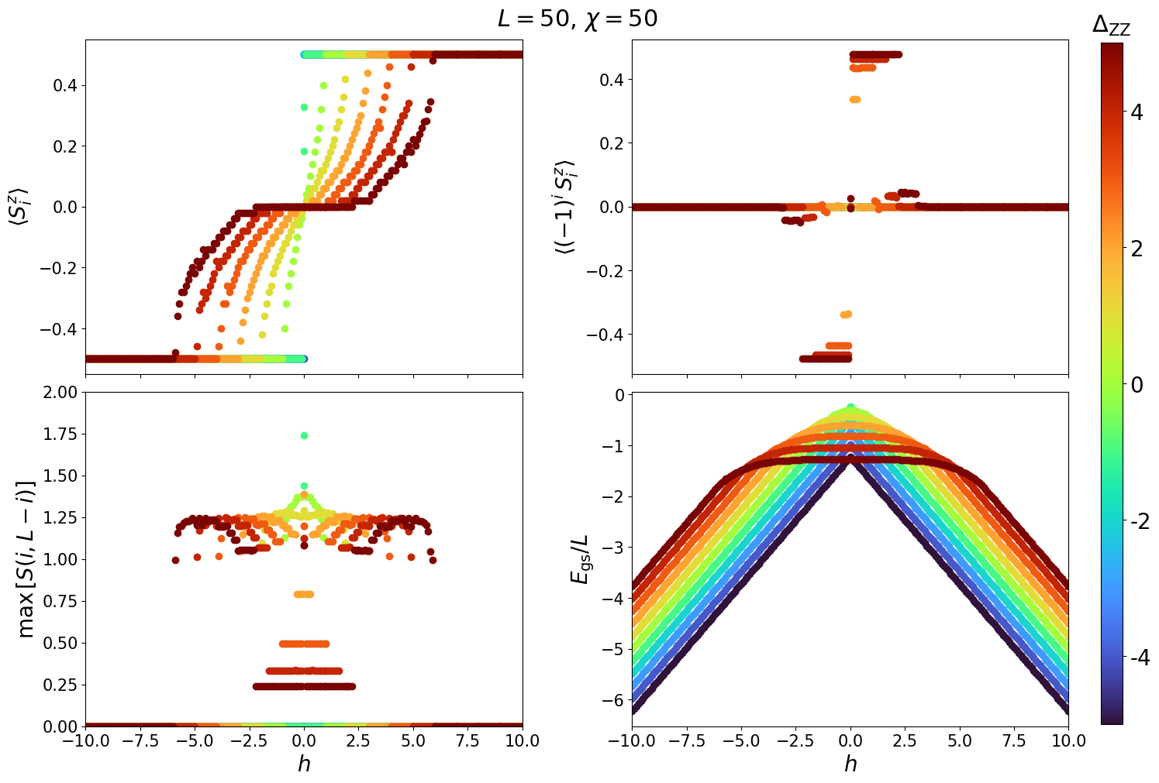
Heisenberg XXZ chain
Anti-ferromagnetic : $Δ_{ZZ}>1, \left|h\right|<h_{c1}≈\frac{1}{2}Δ_{ZZ}$
Tomonaga-Luttinger Liquid (TLL, Gapless) : $−1<Δ_{ZZ}<1,h_{c1}<\left|h\right|<h_{c2}≈Δ_{ZZ}$
Ferromagnetic : $Δ_{ZZ}<−1, \left|h\right|>h_{c2}$

Slide 22
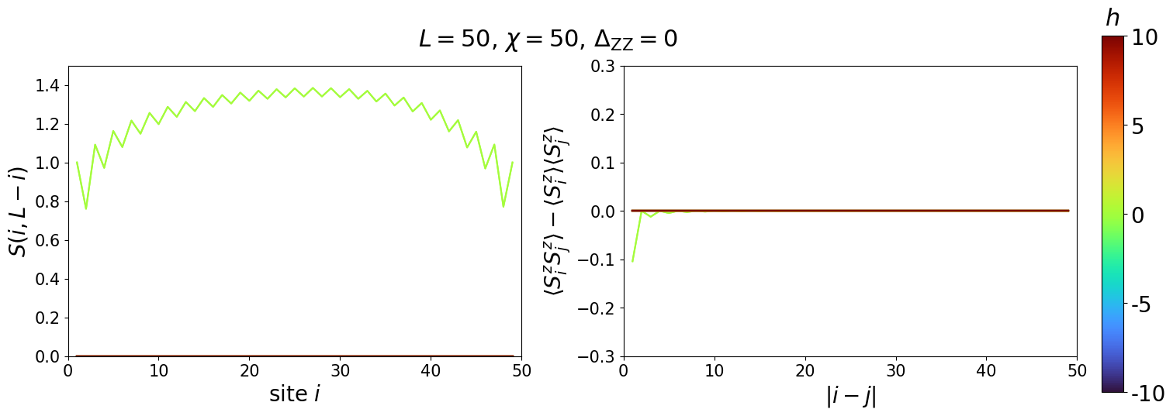
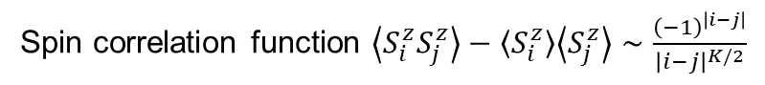
Heisenberg XXZ chain
Spin correlation function $\left\langle S_{i}^{z}S_{j}^{z}\right\rangle −\left\langle S_{i}^{z}\right\rangle \left\langle S_{j}^{z}\right\rangle ∼\frac{{\left(−1\right)}^{\left|i−j\right|}}{{\left|i−j\right|}^{K/2}}$

Slide 23
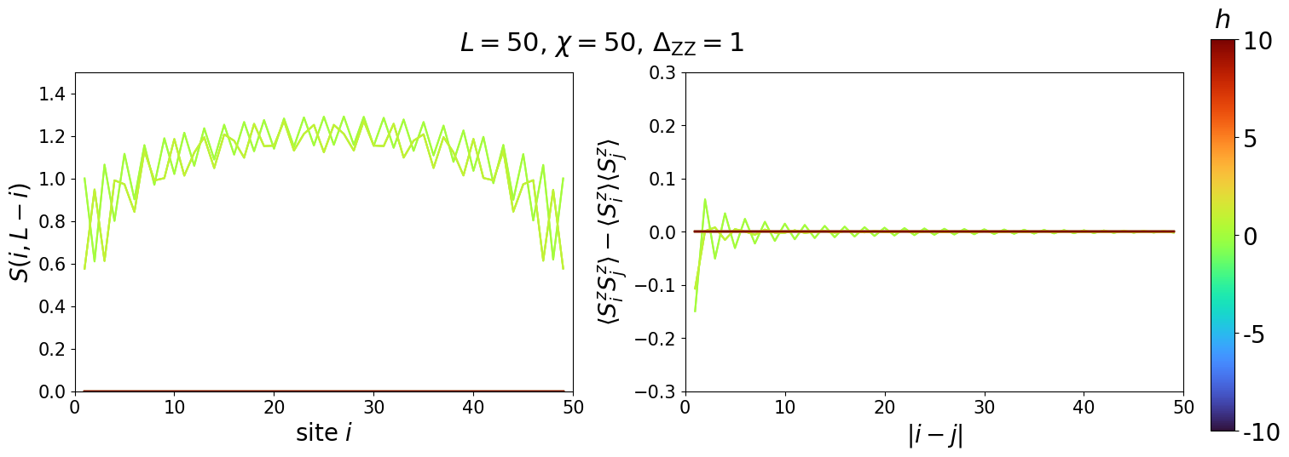
Heisenberg XXZ chain
Spin correlation function $\left\langle S_{i}^{z}S_{j}^{z}\right\rangle −\left\langle S_{i}^{z}\right\rangle \left\langle S_{j}^{z}\right\rangle ∼\frac{{\left(−1\right)}^{\left|i−j\right|}}{{\left|i−j\right|}^{K/2}}$

Slide 24

Heisenberg XXZ chain
Spin correlation function $\left\langle S_{i}^{z}S_{j}^{z}\right\rangle −\left\langle S_{i}^{z}\right\rangle \left\langle S_{j}^{z}\right\rangle ∼\frac{{\left(−1\right)}^{\left|i−j\right|}}{{\left|i−j\right|}^{K/2}}$

Slide 25

Heisenberg XXZ chain
Spin correlation function $\left\langle S_{i}^{z}S_{j}^{z}\right\rangle −\left\langle S_{i}^{z}\right\rangle \left\langle S_{j}^{z}\right\rangle ∼\frac{{\left(−1\right)}^{\left|i−j\right|}}{{\left|i−j\right|}^{K/2}}$

Slide 26

Heisenberg XXZ chain
Spin correlation function $\left\langle S_{i}^{z}S_{j}^{z}\right\rangle −\left\langle S_{i}^{z}\right\rangle \left\langle S_{j}^{z}\right\rangle ∼\frac{{\left(−1\right)}^{\left|i−j\right|}}{{\left|i−j\right|}^{K/2}}$

Slide 27


Heisenberg XXZ chain
Spin correlation function $\left\langle S_{i}^{z}S_{j}^{z}\right\rangle −\left\langle S_{i}^{z}\right\rangle \left\langle S_{j}^{z}\right\rangle ∼\frac{{\left(−1\right)}^{\left|i−j\right|}}{{\left|i−j\right|}^{K/2}}$

Slide 28


Heisenberg XXZ chain: Luttinger parameters
Spin correlation function $\left\langle S_{i}^{z}S_{j}^{z}\right\rangle −\left\langle S_{i}^{z}\right\rangle \left\langle S_{j}^{z}\right\rangle ∼\frac{{\left(−1\right)}^{\left|i−j\right|}}{{\left|i−j\right|}^{K/2}}$

Slide 29


Single-orbital Fermi-Hubbard model
U(1) spin symmetry + U(1) charge symmetry $→$ Number of electrons and spin is a good quantum number
SU(2) spin symmetry since there is no external magnetic field
Particle-hole symmetry when $U=2μ→$ Half filling $:\left\langle n_{i}\right\rangle −1=0$ and SU(2) charge symmetry (for even L)
Spin (connected) correlation functions $:C^{s}\left(\left|i−j\right|\right)=\left\langle S_{i}^{z}S_{j}^{z}\right\rangle −\left\langle S_{i}^{z}\right\rangle \left\langle S_{j}^{z}\right\rangle ∼\frac{{\left(−1\right)}^{\left|i−j\right|}}{\left|i−j\right|}$at half filling
Charge (connected) correlation functions $:C^{c}\left(\left|i−j\right|\right)=\left\langle n_{i}n_{j}\right\rangle −\left\langle n_{i}\right\rangle \left\langle n_{j}\right\rangle :$ polynomial vs exponential decay
Charge gap $:Δ_{C}\left(N\right)=E_{gs}\left(N+1\right)−E_{gs}(N)$ for $N$ occupied electrons: insulator vs metal

Slide 30


Single-orbital Fermi-Hubbard model: fillings
Filling vs Chemical potential

Slide 31


Single-orbital Fermi-Hubbard model: ground state energy
Filling vs Ground state energy and double occupancy

Slide 32

Single-orbital Fermi-Hubbard model: von Neumann entropy
Filling vs Neumann entropy

Slide 33

Single-orbital Fermi-Hubbard model

Slide 34

Single-orbital Fermi-Hubbard model: charge gap
Lieb et al., PRL (1958)
Mott insulator at half filling, Metal (Luttinger liquid) else

Slide 35

Single-orbital Fermi-Hubbard model: correlations
Spin (connected) correlation functions $:C^{s}\left(\left|i−j\right|\right)=\left\langle S_{i}^{z}S_{j}^{z}\right\rangle −\left\langle S_{i}^{z}\right\rangle \left\langle S_{j}^{z}\right\rangle ∼\frac{{\left(−1\right)}^{\left|i−j\right|}}{\left|i−j\right|}$at half filling
Charge (connected) correlation functions $:C^{c}\left(\left|i−j\right|\right)=\left\langle n_{i}n_{j}\right\rangle −\left\langle n_{i}\right\rangle \left\langle n_{j}\right\rangle :$ polynomial vs exponential decay

Slide 36

Single-orbital Fermi-Hubbard model: correlations
Spin (connected) correlation functions $:C^{s}\left(\left|i−j\right|\right)=\left\langle S_{i}^{z}S_{j}^{z}\right\rangle −\left\langle S_{i}^{z}\right\rangle \left\langle S_{j}^{z}\right\rangle ∼\frac{{\left(−1\right)}^{\left|i−j\right|}}{\left|i−j\right|}$at half filling
Charge (connected) correlation functions $:C^{c}\left(\left|i−j\right|\right)=\left\langle n_{i}n_{j}\right\rangle −\left\langle n_{i}\right\rangle \left\langle n_{j}\right\rangle :$ polynomial vs exponential decay

Slide 37

Single-orbital Fermi-Hubbard model: correlations
Spin (connected) correlation functions $:C^{s}\left(\left|i−j\right|\right)=\left\langle S_{i}^{z}S_{j}^{z}\right\rangle −\left\langle S_{i}^{z}\right\rangle \left\langle S_{j}^{z}\right\rangle ∼\frac{{\left(−1\right)}^{\left|i−j\right|}}{\left|i−j\right|}$at half filling
Charge (connected) correlation functions $:C^{c}\left(\left|i−j\right|\right)=\left\langle n_{i}n_{j}\right\rangle −\left\langle n_{i}\right\rangle \left\langle n_{j}\right\rangle :$ polynomial vs exponential decay

Slide 38

Single-orbital Fermi-Hubbard model: correlations
Spin (connected) correlation functions $:C^{s}\left(\left|i−j\right|\right)=\left\langle S_{i}^{z}S_{j}^{z}\right\rangle −\left\langle S_{i}^{z}\right\rangle \left\langle S_{j}^{z}\right\rangle ∼\frac{{\left(−1\right)}^{\left|i−j\right|}}{\left|i−j\right|}$at half filling
Charge (connected) correlation functions $:C^{c}\left(\left|i−j\right|\right)=\left\langle n_{i}n_{j}\right\rangle −\left\langle n_{i}\right\rangle \left\langle n_{j}\right\rangle :$ polynomial vs exponential decay

Slide 39

Single-orbital Fermi-Hubbard model: correlations
Spin (connected) correlation functions $:C^{s}\left(\left|i−j\right|\right)=\left\langle S_{i}^{z}S_{j}^{z}\right\rangle −\left\langle S_{i}^{z}\right\rangle \left\langle S_{j}^{z}\right\rangle ∼\frac{{\left(−1\right)}^{\left|i−j\right|}}{\left|i−j\right|}$at half filling
Charge (connected) correlation functions $:C^{c}\left(\left|i−j\right|\right)=\left\langle n_{i}n_{j}\right\rangle −\left\langle n_{i}\right\rangle \left\langle n_{j}\right\rangle :$ polynomial vs exponential decay

Slide 40

Single-orbital Fermi-Hubbard model: correlations
Spin (connected) correlation functions $:C^{s}\left(\left|i−j\right|\right)=\left\langle S_{i}^{z}S_{j}^{z}\right\rangle −\left\langle S_{i}^{z}\right\rangle \left\langle S_{j}^{z}\right\rangle ∼\frac{{\left(−1\right)}^{\left|i−j\right|}}{\left|i−j\right|}$at half filling
Charge (connected) correlation functions $:C^{c}\left(\left|i−j\right|\right)=\left\langle n_{i}n_{j}\right\rangle −\left\langle n_{i}\right\rangle \left\langle n_{j}\right\rangle :$ polynomial vs exponential decay

Slide 41

Single-orbital Fermi-Hubbard model: correlations
Spin (connected) correlation functions $:C^{s}\left(\left|i−j\right|\right)=\left\langle S_{i}^{z}S_{j}^{z}\right\rangle −\left\langle S_{i}^{z}\right\rangle \left\langle S_{j}^{z}\right\rangle ∼\frac{{\left(−1\right)}^{\left|i−j\right|}}{\left|i−j\right|}$at half filling
Charge (connected) correlation functions $:C^{c}\left(\left|i−j\right|\right)=\left\langle n_{i}n_{j}\right\rangle −\left\langle n_{i}\right\rangle \left\langle n_{j}\right\rangle :$ polynomial vs exponential decay

Slide 42

Single-orbital Fermi-Hubbard model: correlations
Spin (connected) correlation functions $:C^{s}\left(\left|i−j\right|\right)=\left\langle S_{i}^{z}S_{j}^{z}\right\rangle −\left\langle S_{i}^{z}\right\rangle \left\langle S_{j}^{z}\right\rangle ∼\frac{{\left(−1\right)}^{\left|i−j\right|}}{\left|i−j\right|}$at half filling
Charge (connected) correlation functions $:C^{c}\left(\left|i−j\right|\right)=\left\langle n_{i}n_{j}\right\rangle −\left\langle n_{i}\right\rangle \left\langle n_{j}\right\rangle :$ polynomial vs exponential decay

Slide 43

Single-orbital Fermi-Hubbard model: correlations
Spin (connected) correlation functions $:C^{s}\left(\left|i−j\right|\right)=\left\langle S_{i}^{z}S_{j}^{z}\right\rangle −\left\langle S_{i}^{z}\right\rangle \left\langle S_{j}^{z}\right\rangle ∼\frac{{\left(−1\right)}^{\left|i−j\right|}}{\left|i−j\right|}$at half filling
Charge (connected) correlation functions $:C^{c}\left(\left|i−j\right|\right)=\left\langle n_{i}n_{j}\right\rangle −\left\langle n_{i}\right\rangle \left\langle n_{j}\right\rangle :$ polynomial vs exponential decay

Slide 44

Single-orbital Fermi-Hubbard model: correlations
Spin (connected) correlation functions $:C^{s}\left(\left|i−j\right|\right)=\left\langle S_{i}^{z}S_{j}^{z}\right\rangle −\left\langle S_{i}^{z}\right\rangle \left\langle S_{j}^{z}\right\rangle ∼\frac{{\left(−1\right)}^{\left|i−j\right|}}{\left|i−j\right|}$at half filling
Charge (connected) correlation functions $:C^{c}\left(\left|i−j\right|\right)=\left\langle n_{i}n_{j}\right\rangle −\left\langle n_{i}\right\rangle \left\langle n_{j}\right\rangle :$ polynomial vs exponential decay

Slide 45



Conclusions
DMRG is great !! Can solve non-trivial problems
2025.06.24(Wed) Computation, Learning, and Physics Final Presentation Group 6
SungBin Lee
Senior
Dept. of Physics and Astronomy
JunSoo Kim
Senior
Dept. of Physics and Astronomy
Sehyun Oh
Senior
Dept. of Physics and Astronomy

